Slide 1
Rating prediction project
Project report and steps

Slide 2
Problem Statement:
We have a client who has a website where people write different reviews for technical products. Now they are adding a new feature to their website i.e. The reviewer will have to add stars(rating) as well with the review. The rating is out 5 stars and it only has 5 options available 1 star, 2 stars, 3 stars, 4 stars, 5 stars. Now they want to predict ratings for the reviews which were written in the past and they don’t have a rating. So, we have to build an application which can predict the rating by seeing the review.

Slide 3
Model Building Phase After collecting the data, you need to build a machine learning model. Before model building do all data preprocessing steps involving NLP. Try different models with different hyper parameters and select the best model. Follow the complete life cycle of data science. Include all the steps like
1. Data Cleaning
2. Exploratory Data Analysis
3. Data Preprocessing
4. Model Building
5. Model Evaluation
6. Selecting the best model

Slide 4
Projects steps
Loading data
Data Exploration
Features with Null value
Numerical Features
Do EDA for analysing data Properly
Data Cleaning
Remove some unrelated features
visualize Data
Data transformation
Base Model Performance (Random Forest)
Hyperparameter Tuning
Final Model
Visualize Results

Slide 5
Details
There are 6019 entries in the train data set. The data contains some NaN values too.
Lets check for NaN (null) values in the data
we check the percentage of nan values present in each feature
We might want to remove columns with more than 50% missing values
We check the correlation with the features.
We created some new columns.
We remove some extra data from the existed columns.
We make changes in type of some feature from object to numerical like(int and float).

Slide 6
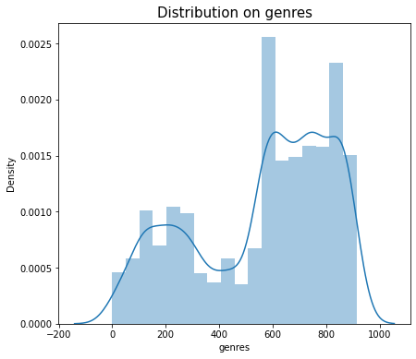
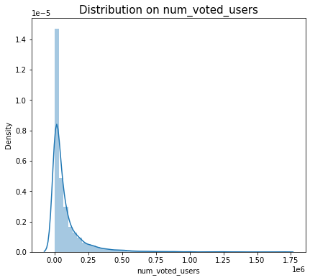
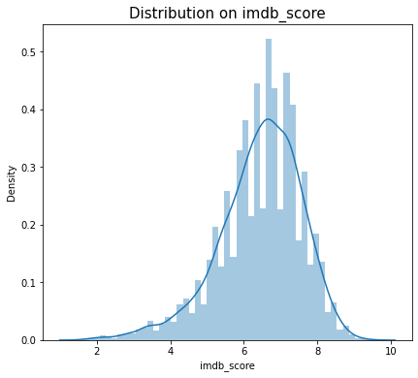
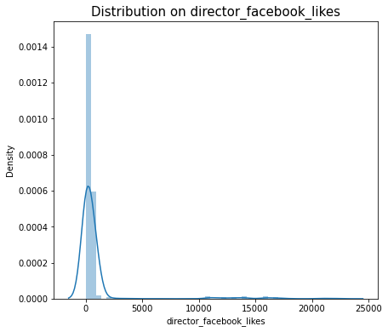
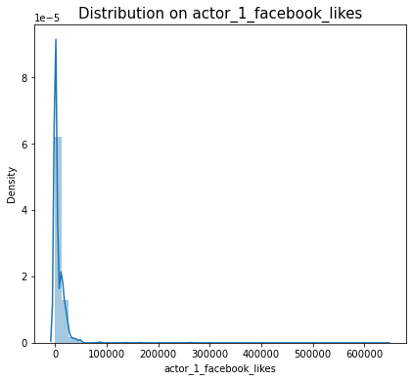
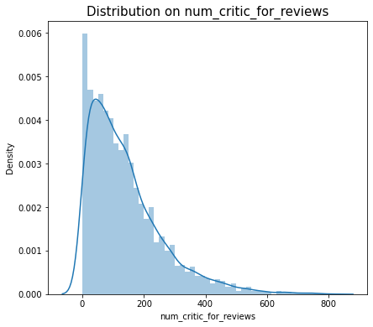
EDA part
Create some distplot for different – different features.

Slide 7
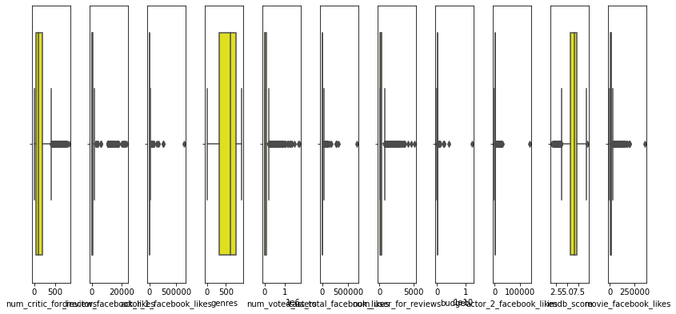
EDA part
Create box plot for all the feature.

Slide 8
Details
We encode the object data type feature with LabelEncoder.
We create some distplot for check the distribution.
We make separation in dependent feature and independent feature.
Create x with independent features and y with dependent feature.
Firstly we fit ExtraTreesRegressor for find the importance of feature of dataset.
We Standardize the X’s feature for better result.
We split the data in train and test dataset for fir more models.

Slide 9
Details
We see that the target feature are in continous form that’s way we apply linear and regressor models.
Here we apply four models.
LinearRegression()
XGBRegressor()
RandomForestRegressor()
DecisionTreeRegressor()

Slide 10
Details
We fit all the models with x_train and y_train data.
We find the score of all models and we find that RandomForestRegressor gave the best result.
We find R2_score with the datasets .
We Find Mean square error and Square root of mean square error.
We create the dist plot with the difference of y_test and Y_pred data for all the models.
We did hyperperameter tuining with RandomizedSearchCV for increase the score’s of models.
We got a slight improvement with hyperparameter tuning
Finaly we find that the DecisionTreeRegressor is the best fit model for our dataset.
We save are model with DecisionTreeRegressor.

Slide 11
Result
Model Accuracy:
DecisionTreeRegressor.
MAE: 0.709196147754193
MSE: 0.9205088969058478
RMSE: 0.9594315488380856

